Slide 1

Test Driven Development
An Overview
Andy Stewart @andystewart79
www.codera.co.uk

Slide 2

About me…
Professional Developer since 2000
Practising TDD for roughly 8 years
Co-founded Codera Ltd this year
Working with The Test People on Client site

Slide 3

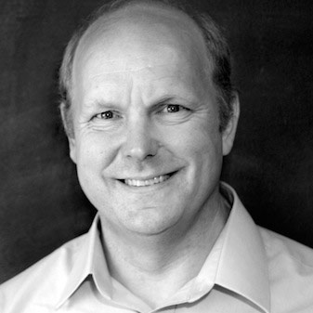
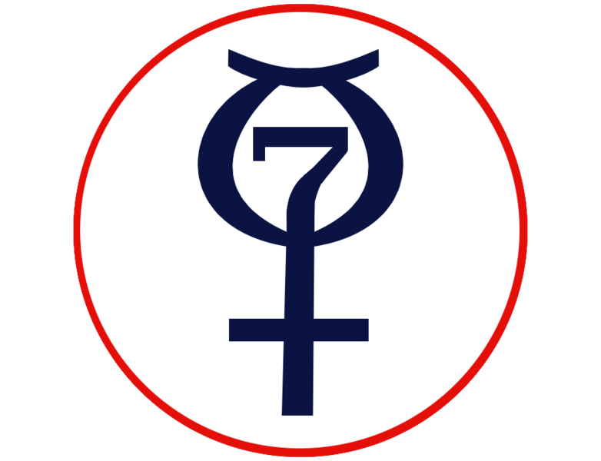
A bit of history…
TDD pronounced dead –DHH (2014)
eXtreme Programming Explained – Beck (1999)
XP
Test Driven Development by Example – Beck (2002)
NASA’s Project Mercury (early 1960s)
Notes:
To shorten the total development time, some formal test documents (such as for acceptance testing) have been developed in parallel (or shortly before) the software is ready for testing. A NASA independent test group can write the test procedures, based on formal requirements and logical limits, before the software has been written and integrated with the hardware.
XP came out of the work Kent Beck did at Chrysler around 1996-99. His book eXtreme Programming Explained was published in 99.
Rules of XP under the coding part talk describe TDD without giving it a name.
Published a book entirely dedicated to TDD.
Blog post from DHH denounced TDD and claimed as a methodology it was dead. Led to a series of hangouts and discussions between DHH, Kent Beck and Martin Fowler which are available on the web.
To shorten the total development time, some formal test documents (such as for acceptance testing) have been developed in parallel (or shortly before) the software is ready for testing. A NASA independent test group can write the test procedures, based on formal requirements and logical limits, before the software has been written and integrated with the hardware.
XP came out of the work Kent Beck did at Chrysler around 1996-99. His book eXtreme Programming Explained was published in 99.
Rules of XP under the coding part talk describe TDD without giving it a name.
Published a book entirely dedicated to TDD.
Blog post from DHH denounced TDD and claimed as a methodology it was dead. Led to a series of hangouts and discussions between DHH, Kent Beck and Martin Fowler which are available on the web.

Slide 4
What is TDD?
Write a failing test
Make it pass
Refactor/Remove duplication
Notes:
A development technique
Quickly write a failing test
Get the test to pass as quickly as possible. Commit any sin necessary to get the bar green as fast as possible. Copy and past code, hard code the answer, etc
Remove duplication/refactor
What it is not –
When the tests are written shortly after the code
When someone writes the tests separately to the implementation and then the two brought together

Slide 5
Why develop like this?
Clean code that works (Ron Jeffries)
Concrete examples
Predictability in development
Immediate feedback
Fear management
Notes:
The goal of Test Driven Development is to provide clean code that works.
One of the main benefits of using TDD is that you are dealing in concrete examples making it quicker and easier to crystalize and communicate what you are trying to achieve. This also makes it much easier when talking to other developers or testers because you can talk in terms of the expected behavior of the system. “So, if I call the calculation passing these two values then I expect the tax rate to come out at Y”, etc.
As you apply TDD you find that you get into a rhythm, writing tests, getting them to pass, tidying up the code and then moving onto the next test. The important thing is to take small steps and keep moving towards your goal. Initially it feels very unnatural to people to take such small steps. It’s quite common to think the solution to a problem is obvious and implement it in one go only to find that it’s not as straightforward as initially thought or there is some complicated corner case to contend with. The benefit of TDD is that you are constantly making progress towards your goal and it’s very easy to scrap an idea that doesn’t work because it’s a case of just undoing the last change you made. In his book Beck talks about teeth on a ratchet and lifting a bucket of water up from a well. The heavier the bucket the closer the teeth on the ratchet need to be, equally the more complicated or gnarly the problem the smaller the steps you need to take with your tests.
One of the most important things to achieve this steady rhythm is a test suite that can be run and provide immediate feedback. As soon as you have implemented some code you should be able to run the test and see if it has made it pass or not. When in the flow then the tests for a single class or module might only need to be run but the tests for the whole component or project should complete quickly enough that they can be run before checkin, i.e. seconds rather than minutes or heaven forbid hours!
Fear – the overall effect of TDD is to manage fear and allow you to change the codebase with confidence.
Test Infected is a term that is used to describe people who have tried TDD and become converted. There working practices are changed forever and you find they write tests earlier and more often. However beware the Test Infected as they can be rather over-zealous sometimes and this is partly what DHH was complaining about in his “TDD is Dead” post.

Slide 6
So why doesn’t everyone do it?
Cost of maintaining tests
Lack of big upfront design
Leads to overly complex design
Previous failed attempts at adoption
Steep learning curve
Notes:
The costs of maintaining tests are both in terms of the time taken to run them, i.e. if you have a suite that takes minutes or hours then you have people sat around waiting for feedback.
There is also the cost of badly written tests which are prone to breaking when changes are made, reducing confidence in the test pack and ultimately leading to the kind of code rot we are trying to avoid.
Some people don’t like it because they argue there is no up front design and it’s an excuse to not think about what you are doing. There is nothing in TDD that says you shouldn’t think about the general design before you start. This is just a fallacy as there is nothing about TDD that says you shouldn’t or can’t design up front. TDD is concerned with closing the gap between creating an implementation and validating it works. If you want to take a day or so out and work out what boxes you want on an architecture diagram then there is nothing to stop you.
The flip side is people say it leads to overly complex design. This is one of the big things that DHH accused TDD of. He argued that people were overly obsessed with getting quick running tests at the cost of compromising the system design by introducing layers and layers of indirection and mocking. Part of his issues were that Rails didn’t lend itself to decoupling objects from the database layer and people went to great lengths to work around the framework.
Quite often you will come across teams or individuals who will say they tried TDD and it didn’t work so they abandoned it.
Most of the problems described here can be explained by the fact that there is a steep learning curve when it comes to TDD. The rules are incredibly simple, write a test, make it pass, refactor, repeat. However there is great skill involved at each stage. What level do you write your tests at? When do you mock something out vs when do you use a real collaborator? How big a jump can you take getting this piece of functionality working? It’s only after working in a TDD manner for a number of years and living with the test suites and the codebase do you find the things that work over time and the things that hold you back from changing the code base.

Slide 7
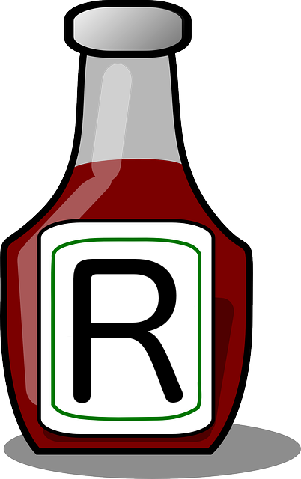
The Secret Sauce
REFACTORING
Constantly refactor
Duplication is the enemy
Hide details behind abstractions
Perhaps the hardest part
Certainly the most neglected
Notes:
Refactoring is what makes TDD really work. I think it’s quite common for people to think that it’s the implementing a single test at a time that is the most important. That is what helps you keep the problem at a manageable level in your head. What helps over the long term is refactoring.
In TDD By Example he described the process as test, implement, remove duplication. So the focus was on removing duplication, people can be quite wooly when talking about refactoring. If you generally keep it in mind the goal here is to remove duplication.
Duplication is what makes code hard to change over time. If we ever need to make a change to the software in the future and there are 4 variations on a calculation then there are 4 places we need to change the code. If we had refactored the code as we went then we would have extracted the common part of the calculation and there would only be one place to make the change.
Use refactoring to hide details behind abstractions. This works in both tests and implementation code. For instance if you are testing a GUI which has a form the user needs to fill in hide it behind a submit form method. The act of actually then filling in the GUI form is taken care of by that implementation. Now the business comes along and says they want to expose the same functionality to other clients but via a web service. Now you can provide a new implementation that fills in the request and sends it to the web service but the test code remains completely unchanged. This is because we have hidden the detail about submitting the form behind an abstraction.
Refactoring is quite a hard thing to do and again is fuzzy. Sometimes it’s not worth removing 2 lines of duplication because it reduces the readability and clarity of the code.
It certainly is the most neglected discipline in development. People tend to blame time pressures saying they don’t have time to refactor the code because they might break it. This is one of the areas where TDD really comes into it’s own. If we have a comprehensive test suite that we have faith in then we can refactor in the knowledge that our tests will catch any mistakes we might make.

Slide 8
What makes a good test?
Asserts ONE thing
Has a good name
e.g. testBug1979 vs shouldRejectMessageWithNoTimestamp
Repeatable
Fails helpfully
Notes:
Asserts only one thing:
- Only one reason to fail
- Easier to reason about the test
- Quicker to get to pass
- Keeps cost of test down
Has a good name:
- describes the behavior under test
- not necessarily the method or function under test
Repeatable:
- can be run again without manual intervention to clear anything down
Fails helpfully
- If the test fails it should indicate clearly why it failed, i.e. expected status to be fail for invalid message.

Slide 9
Different Flavours of TDD
Behavior Driven Development (BDD)
Based on Dan North’s TDD experience
Given/When/Then
Acceptance Test Driven Development (ATDD)
Take acceptance tests one at a time
Normal TDD fleshes out implementation classes
Test Passes = Functionality Completed
Notes:
Generally I haven’t seen BDD work that well wherever it has been applied. Tend to be slow, brittle and get ignored when they break. They are also expensive to get up and running in terms of the amount of effort to get the code behind the scripts running and then the effort involved in keeping the language at the right level, i.e. not too detailed but not too vague.

Slide 10
Further Reading
Test-Driven Development by Example
(Kent Beck)
Growing Object-Oriented Software Guided by Tests
(Steve Freeman & Nat Pryce)
“Is TDD Dead?” conversation:
http://martinfowler.com/articles/is-tdd-dead/

Slide 11
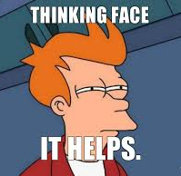
Any Questions?
Andy Stewart
@andystewart79
www.codera.co.uk

